Slide 1



Prof. Dixon Olu. Torimiro, Ph.D., MCRA, IES.

Slide 2


Negotiating skill

Slide 3


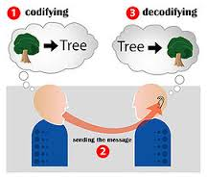


Communication skill

Slide 4



Versatility/multi-tasking skill

Slide 5
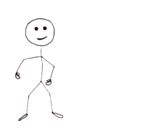
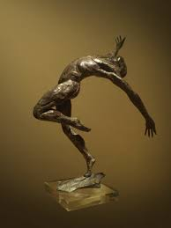
Malleable/flexible Skill

Slide 6


Life-long learning Skill

Slide 7




ICT knowledge and skills

Slide 8




Creative/critical thinking skills

Slide 9




Entrepreneurship/employability skills

Slide 10

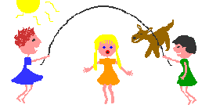

Organizational/team work skills

Slide 11


Research and information literacy skills

Slide 12

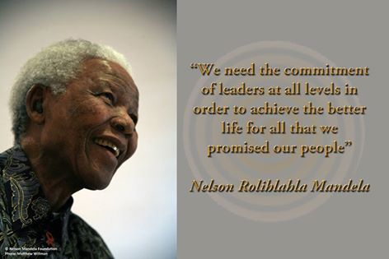
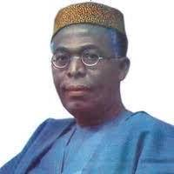
Social responsibility and leadership skills

Slide 13


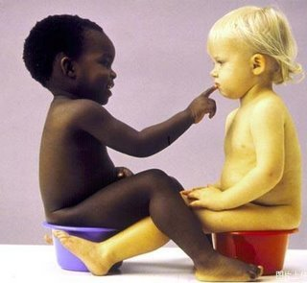
Inter-personal/human relations skills

Slide 14


Thank you for listening

